Slide 1
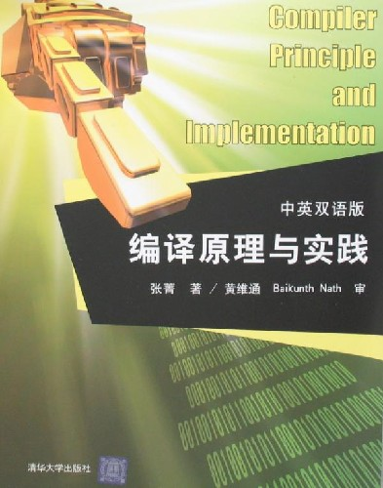
Compiler Principles and Implementation
LIJIE LI
College of Computer Science & Technology
Harbin Engineering University

Slide 2
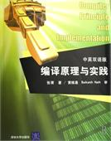
Class Textbook:
  Compiler Principles and Implementation,
  Prof. Zhang Jing,

Slide 3


Reference Book:
  Compiler Construction: principles and practice,
  Kenneth Louden,

Slide 4
Course Goals and Objectives
To provide an introduction to the field of compiler construction.
To understand the importance of efficient compilation process for modern computing.
To study the basic organization and operation of a compiler.
To study theoretical techniques, such as automata theory, involved in compiler development.

Slide 5
Cheating/Collaboration
Not Tolerated in Any Form.
Severe Penalties are Likely.
All Homeworks/Some Projects Represent Individual Effort (or if team work is assignmed they represent the collaborative efforts of the team’s members)
Cooperative Problem Solving and Sharing Code is NOT Permitted and Will Likely Lead to Fs!

Slide 6
Lateness Policies/Exams
Late Assignments (Homeworks/Projects) will be Accepted with Penalties. No penalties will apply only to students who obtain prior permission.
Prior Permission: Contact the Instructor Three Days Before the Due Date
Emergencies: Illness, Death in the Family, etc.
Penalty for late homework assignment is 5 points a day.
No homework is accepted after it is discussed in class.
No homework is accepted after the last day of class.

Slide 7
Class Attendance
  Class attendance is recommended. On occasions that you cannot avoid being absent, you are responsible for getting class notes and assignments.
  Students are encouraged to ask questions and make suggestions.

Slide 8
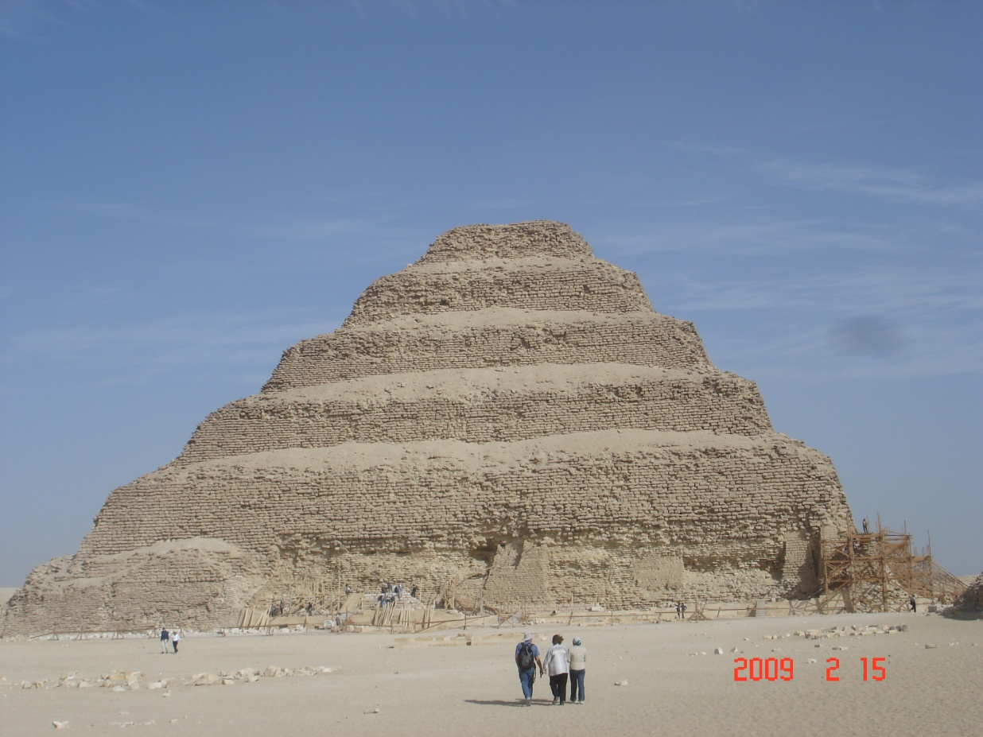
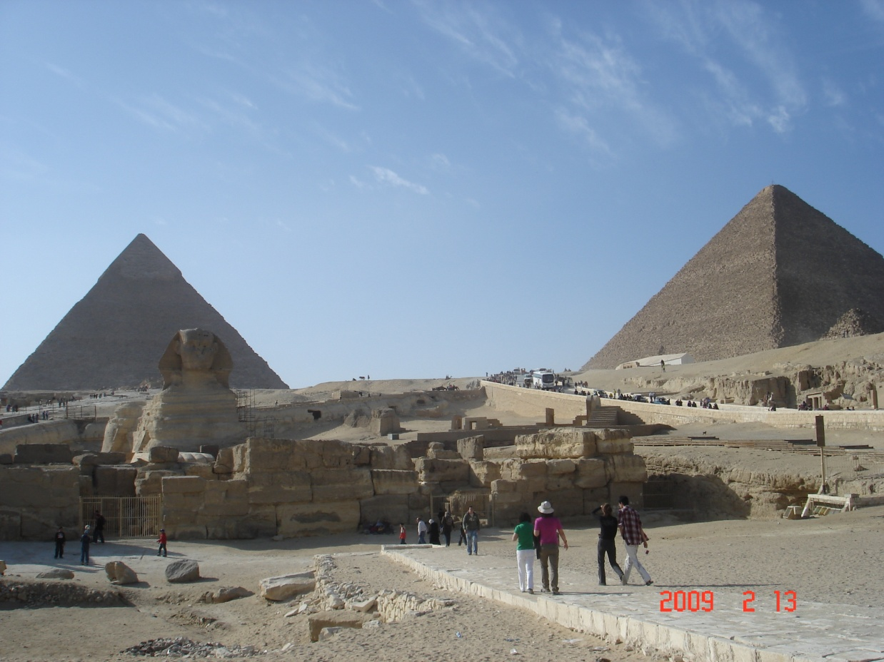
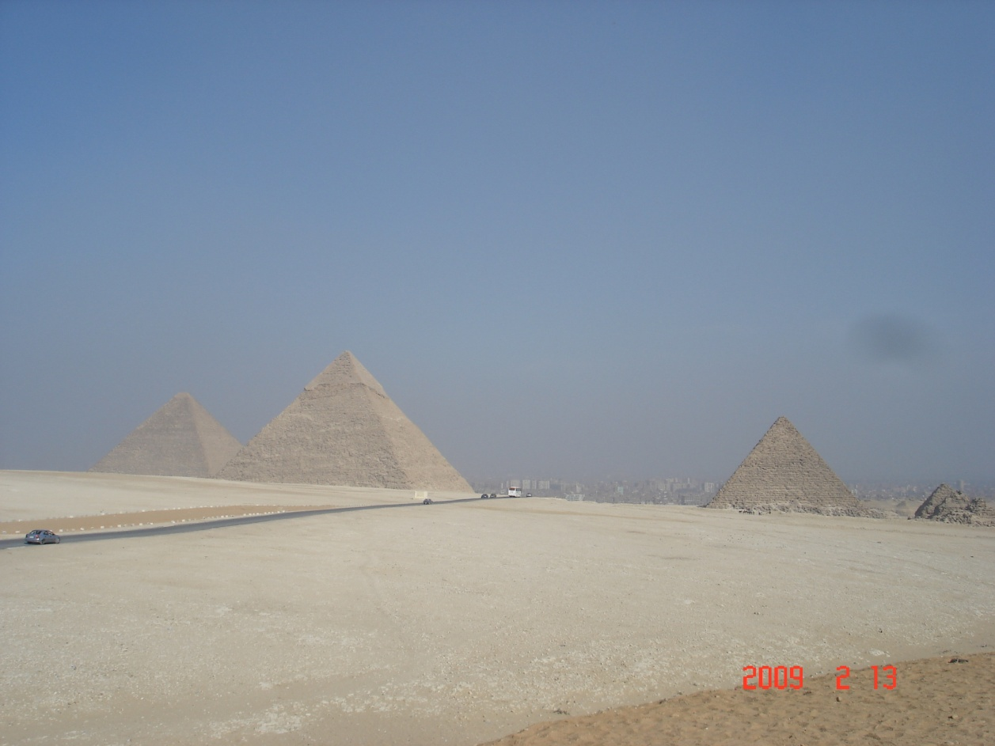
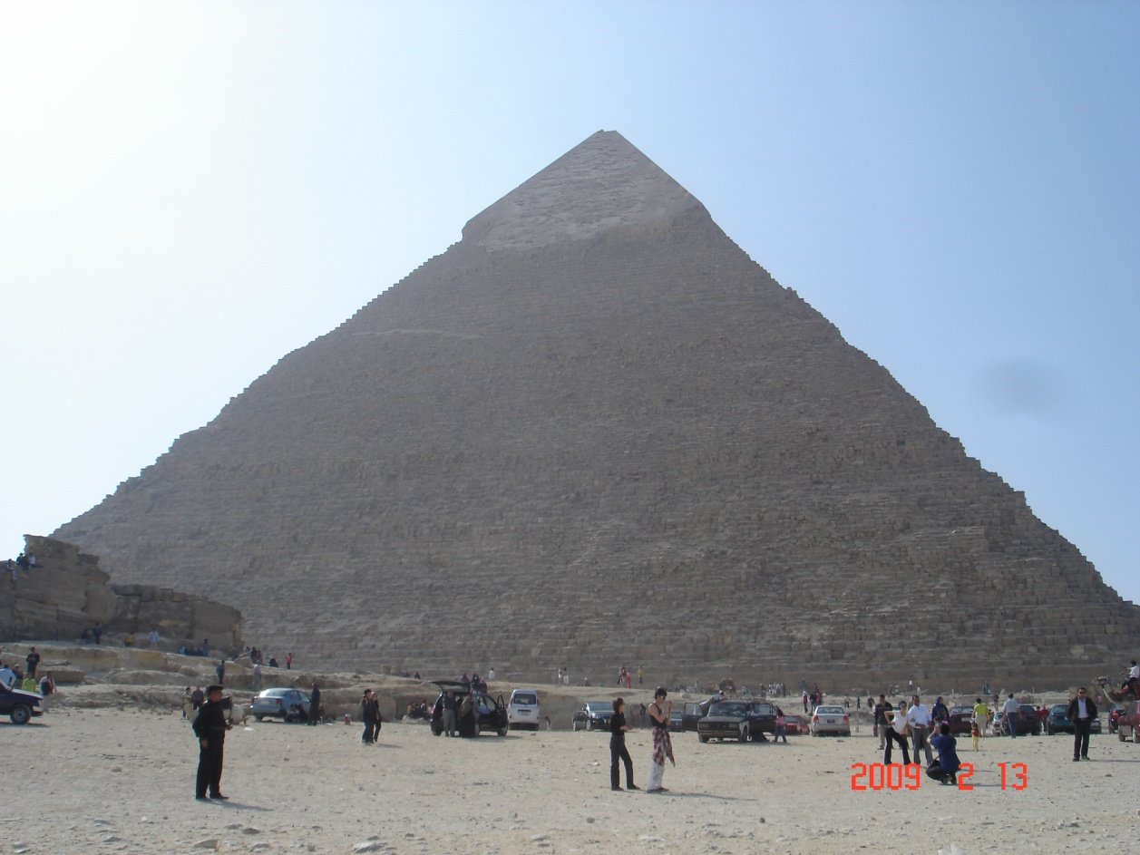
Computing in the beginning of time....

Slide 9
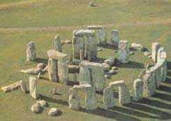
Computing in the beginning of time....
?

Slide 10
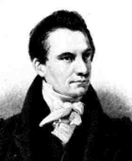
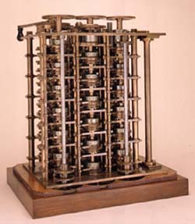
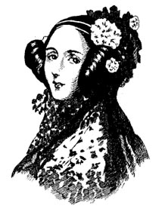
Computing in the beginning of time
the man...
... the legend
and this
is only
a small
part of
the machine!
the programmer
Charles Babbage
The Difference Engine” (1822)
Lady Ada of Lovelace
how do you program this?? Changing Gears!

Slide 11
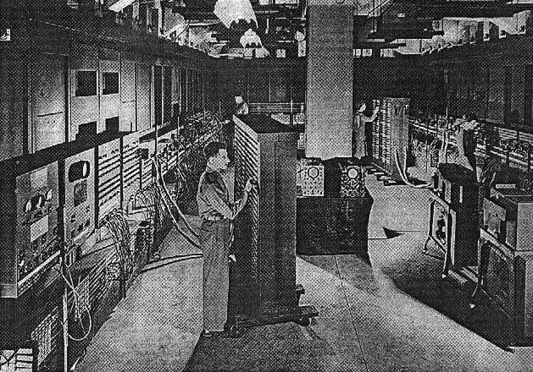
Computers!
Electronic Numerical Integrator and Computer --- ENIAC, 1942
how do you program this?? Flicking Switches!

Slide 12
COMPILERS
A compiler is a program takes a program written in a source language and translates it into an equivalent program in a target language.
source program target program
error messages
COMPILER
( Normally a program written in
a high-level programming language))
( Normally the equivalent program in
machine code – relocatable object file)

Slide 13
Other Applications
In addition to the development of a compiler, the techniques used in compiler design can be applicable to many problems in computer science.
  Techniques used in a lexical analyzer can be used in text editors, information retrieval system, and pattern recognition programs.
  Techniques used in a parser can be used in a query processing system such as SQL.
  Many software having a complex front-end may need techniques used in compiler design.
    A symbolic equation solver which takes an equation as input. That program should parse the given input equation.

Slide 14
Timeline
the 1940’s.
Code is hand generated at 0-1 level and entered by physical switches.
Hardware is rewired according to the program.
the early 1950’s.
First attempts to abstraction.
Grace Murray Hopper:
  “translation is a compilation of a sequence of machine-language subprograms selected from a library.”
  first “compiler” A-0 (by G. M. Hopper)
  Code now is written in Assembly form.
the late 1950’s.
FORTRAN is born together with its Compiler!!!

Slide 15
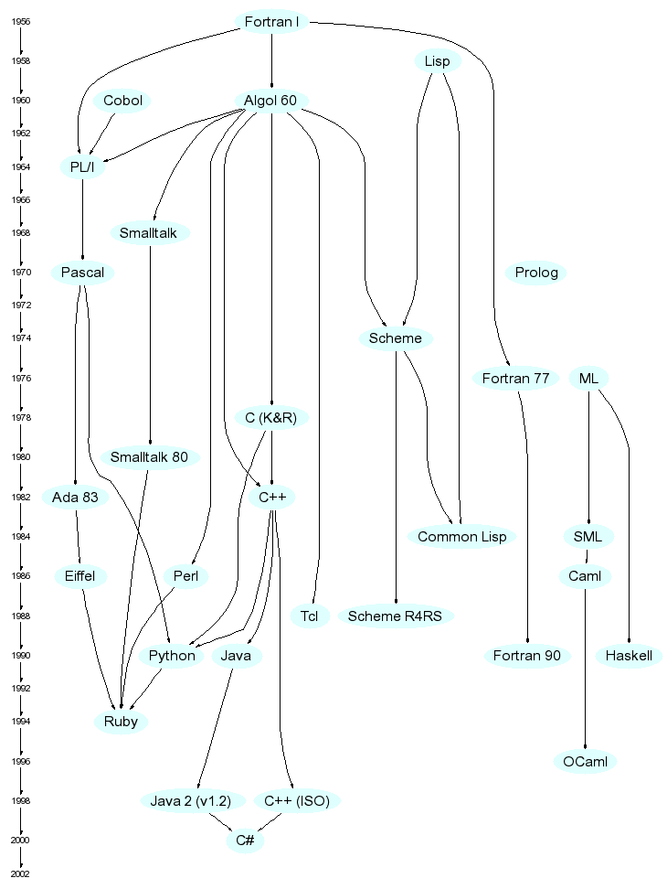
Fortran
diagram from http://merd.net/pixel/language-study/diagram.html

Slide 16
the 1960’s
ALGOL 60
  The first Language with a
  formal grammar specification
  more on this later on (in every meeting of this class!)
FORTRAN gets improved.
Language theory is better understood, it evolves and revolutionizes compiler design.
First “Syntax-Directed Compiler” is born in 1961.
PASCAL is born (Wirth, 1968).
First attempts at automating compiler construction using elements of Formal Language Theory.
Notes:
Formal Language Theory形式语言理论

Slide 17
The 1970’s, 80’s, 90’s
C programming Language is born with its compiler (1972). Distributed as part of the UNIX operating system.
BASIC is born (1975).
“Compiler-Compiler” Tools start to be developed and used extensively.
Success of PCs brings compilers and interpreters in everyone’s home.

Slide 18
Today
Compilers are everywhere.
“Programming” (in the strict sense)
is only one application domain...
  TeX and LaTeX
    language source is compiled into a document.
  Postscript
    language source is translated by laser printers to printer machine level instructions that print a document.
  Mathematica / Matlab
    use a language to specify mathematical operations.
  Verilog / VHDL
    compiles into a circuit

Slide 19
Happy Term

